Slide 1
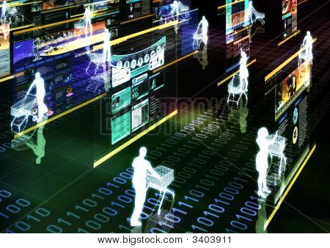
Summary and outlook

Slide 2
Agenda
Summary and outlook
Summary
Outlook
References

Slide 3
Summary
Recommender systems have their roots in various research areas, such as
information retrieval,
information filtering, and
text classification.
Recommender systems apply methods from different fields, such as
machine learning,
data mining, and
knowledge-based systems.
Addressed main topics
Basic recommendation algorithms
Knowledge-based and hybrid approaches
Evaluation of recommender systems and their business value
Recent research topics

Slide 4
Outlook on the next-generation recommenders (1)
Improved collaborative filtering techniques
Use more data sources such as tagging data, demographic information, and time data
Combine different techniques (predictors)
Automatic fine-tuning of parameters
More scalable and more accurate algorithms
Netflix Prize competition (www.netflixprize.com) gave CF research an additional boost
Multicriteria recommender systems
Exploiting multicriteria ratings containing contextual information as an additional source of knowledge for improving the accuracy
Context awareness
Taking time aspects, geographical location and additional context aspects of the user into account
Emotional context ("I fell in love with a boy. I want to watch a romantic movie.")
Group recommendations
Accompanying persons? ("Recommendations for a couple or for friends?")

Slide 5
Outlook on the next-generation recommenders (2)
Better explanations that change the way the user interface works
More elaborate user interaction models
Natural language processing techniques,
dialog-based systems for interactive preference, and
multimodal and multimedia-enhanced rich interfaces
are important steps in the transition between classical recommender systems and virtual advisors.
Recommendation techniques will merge into other research fields
User modeling
Personalized reasoning
…
Next-generation recommenders might someday be able to simulate the behavior of an experienced salesperson instead of only filtering and ranking items from a given catalog.

Slide 6
Credits
Slide authors:
Mouzhi Ge, TU Dortmund
Fatih Gedikli, TU Dortmund
Dietmar Jannach, TU Dortmund
Zeynep Karakaya, TU Dortmund
Markus Zanker, Alpen-Adria-Universitaet Klagenfurt

Slide 7
Thank you for your attention!
Questions?
Questions?
Questions?
ACM RecSys
Recommender Systems
http://recsys.acm.org
ACM SIGIR
Information Retrieval
http://www.sigir.org
ACM SIGKDD
Knowledge Discovery and Data Mining
www.sigkdd.org
IUI
Intelligent User Interfaces
http://iuiconf.org
http://www.recommenderbook.net
Recommender Systems –
An Introduction by
Dietmar Jannach, Markus Zanker,
Alexander Felfernig and Gerhard Friedrich
Cambridge University Press, 2011

